Slide 1
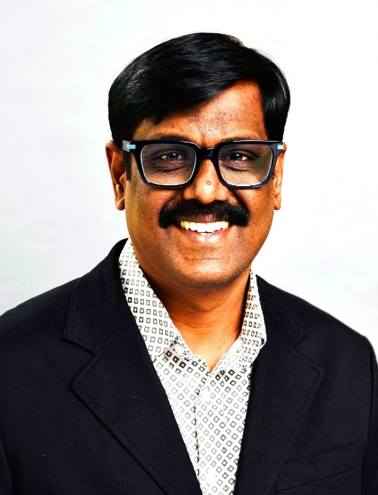
Audhithan (Audhi) is a Solution Architect with over 18 years of global consulting experience, primarily serving major downstream oil and gas clients. He has held pivotal roles including Supply Chain Lead, Solution Architect, and SAP IS-Oil Subject Matter Expert (SME), delivering transformative results across complex, multi-geography operations.
Audhi brings deep technical and functional expertise in SAP IS-Oil, Materials Management (MM), and Sales & Distribution (SD) modules, with specialized focus in Trading and Hydrocarbon Value Chain processes. His extensive project portfolio includes six full-cycle SAP implementation projects for leading energy majors, where he provided end-to-end solution architecture, process leadership, and integration strategy. Audhi has been instrumental in architecting and delivering integrated solutions encompassing trading, contract management, hydrocarbon value chain optimization, and transportation settlement—yielding tangible improvements in operational efficiency and business performance.
He has successfully led greenfield SAP implementations and large-scale rollouts spanning primary and secondary cost management for Upstream, Midstream, and Downstream supply chain operations. Renowned for his capability in process integration and designing holistic solutions, Audhi excels at both technical and functional dimensions of SAP landscapes. He is a proven team leader, adept at managing diverse, cross-functional teams across global locations.
Prior to Deloitte, Audhi held senior consulting roles with Accenture, IBM Consulting, NTT Data, and Tata Technologies, where he consistently demonstrated thought leadership and industry best practices.
Representative Clients: SHELL, TOTAL, PETRONAS, SCHLUMBERGER, ETP, BP, SUNCOR, SUNOCO, EXXONMOBIL
Audhithan Muthuvelan(Audhi)
Specialist Leader /Senior Manager
Deloitte Consulting
Oil & Gas, Hydrocarbon Value Chain
& Trading
18+ years of consulting Experience

